Slide 1
PREDICT CUSTOMER CHURN FOR A TELECOM USING PYTHON & MACHINE LEARNING
GROUP 3 -
08. JASLEEN KAUR
13. KUNAL NIMJE
34. VAISHALI CHAUHAN
51. NISHTHA GUPTA

Slide 2
REASONS WHY CUSTOMER RETENTION IS KEY TO BUSINESS
Customer Churn occurs when subscribers or customers stops using a company’s services. A business typically treats a customer as churned once a specific amount of time has passed since the customers last interaction with the business or service.
Customer retention–the act of keeping current customers that you have already spent money acquiring–is extremely important for any business.
Attracting a new customer costs, on average, five times as much as keeping an existing one, and depending on the industry, it can cost up to 30 times as much to acquire a new customer vs. retaining an existing customer!
Increasing customer retention rates by just 5% increases profits by 25% to 95%.
Retaining customers is obviously important for companies, because it boosts that companies revenue and helps the company to build a meaningful relationship with the customer.

Slide 3
5 REASONS WHY CUSTOMER RETENTION IS IMPORTANT
1. Companies save money on marketing.
2. Repeat purchases from repeat customers means repeat profit.
3. Free word-of-mouth advertising.
4. Retained customers provide valuable feedback.
5. Previous customers will pay premium prices.

Slide 4
AIM OF THE PROJECT
TO PREDICT CUSTOMER CHURN FOR A TELECOM COMPANY USING PYTHON & MACHINE LEARNING
The analysis focuses on analyzing behavior of telecom customers and predict who are more likely to leave the platform.
Intend is to find out the most striking behavior of customers through exploratory data analysis and later on use some of the predictive analytics techniques to determine the customers who are most likely to churn.

Slide 5
INFORMATION OF THE DATASET
Each row represents a customer, each column contains customer’s attributes described on the column Metadata.
Contains 7043 rows (customers) and 21 columns (features)
The Data Set consists of the following:
Churn : Customers who left within the last month
Services : Signed up each customer – phone, multiple lines, internet, online security, online backup, device protection, tech support, and streaming TV and movies
Customer account information : how long they’ve been a customer, contract, payment method, paperless billing, monthly charges, and total charges
Demographic info about customers : gender, age range, and if they have partners and dependents

Slide 6
REASONS FOR CHOOSING THIS DATASET
Sample size: 7043 rows X 21 column
For small (Speed); For large (accuracy)
Small margin of error
No missing values
Describes various factors that affect customer churn such as : Services that each customer has signed up for, Demographic info, Customer account information (tenure, total and monthly charges, payment method)

Slide 7
PROGRAMMING

Slide 8
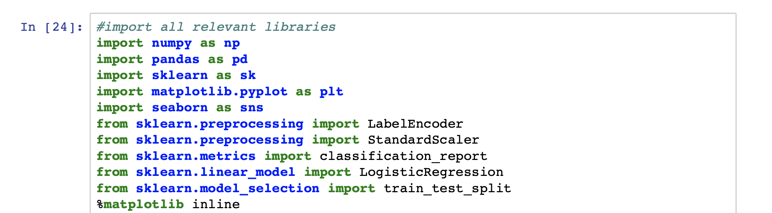
LIBRARIES USED
Import some libraries that will be used throughout this program

Slide 9
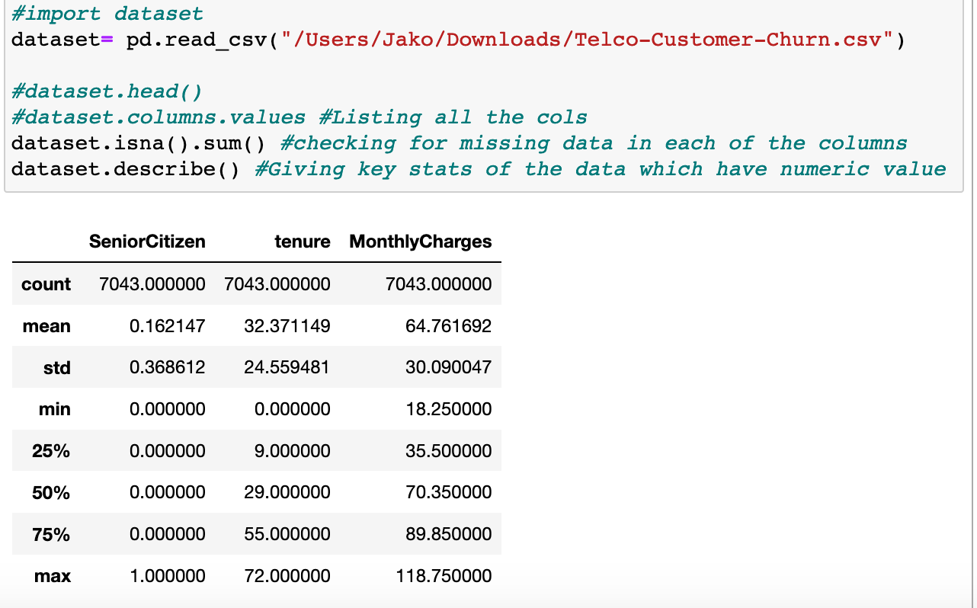
LOAD THE DATA
Importing the dataset and Store the data into a dataframe ‘dataset’.
Then, check the dataset for missing values (if any) and displaying key stats about the data

Slide 10
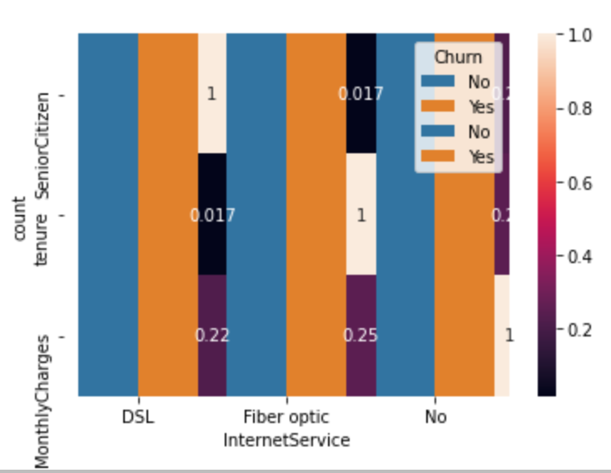
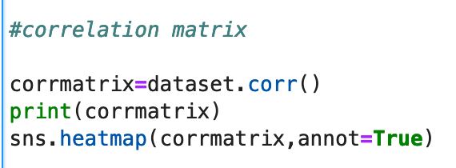
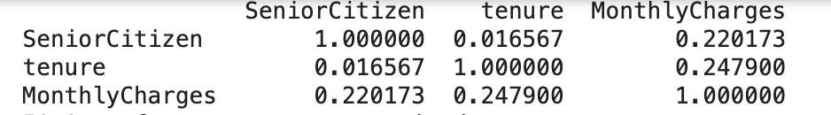
Correlation Matrix
By plotting the correlation matrix using corr() from Pandas, we can observe that
There is low relationship between tenure and monthly charges, senior citizen and monthly charges and Senior Citizen and tenure

Slide 11
ANALYZED DATA

Slide 12
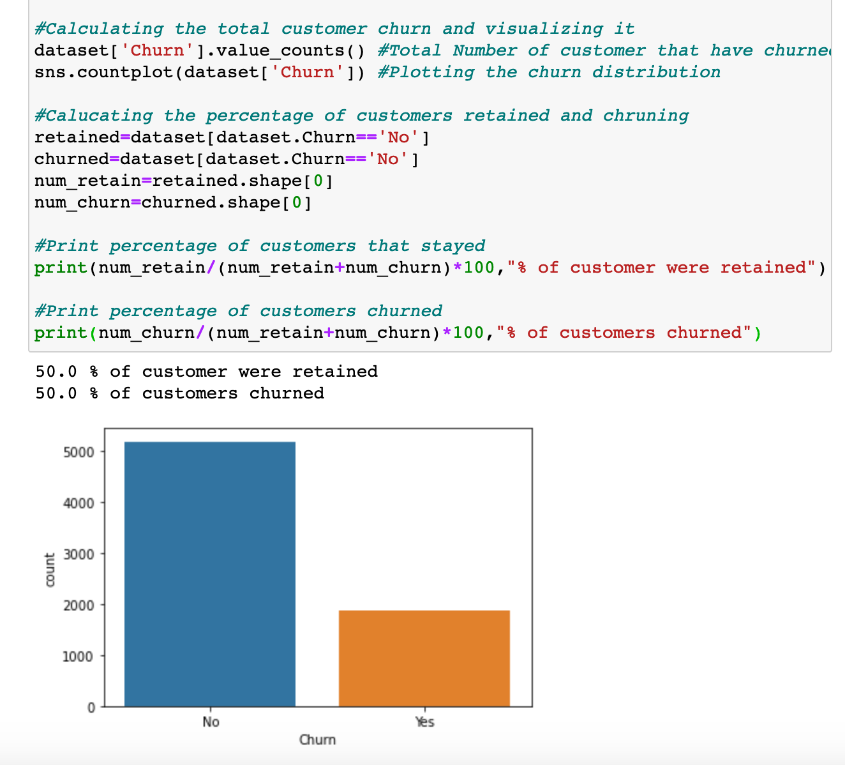
VISUALISATION OF TOTAL DISTRIBUTION OF CUSTOMER CHURN COUNT
In order to check how churn count is distributed and what % of customers are churning and retained, we visualised the relationship using matplotlib

Slide 13
VISUALISATION OF TOTAL DISTRIBUTION OF CUSTOMER CHURN COUNT
INSIGHTS DERIVED
About 5,174 customers were retained (did not churn) and 1,869 customers churned.
So, about 73.46% of the customers stayed or were retained and about 26.54% of the customers churned. This is important information for when I try to evaluate my model to predict customer churn, because it means that just by always guessing a random customer to have been retained from the data set, we have a 73.46% chance of guessing correctly.
So, we want the model’s accuracy to classify/predict if a customer will churn to be higher than that percentage.

Slide 14
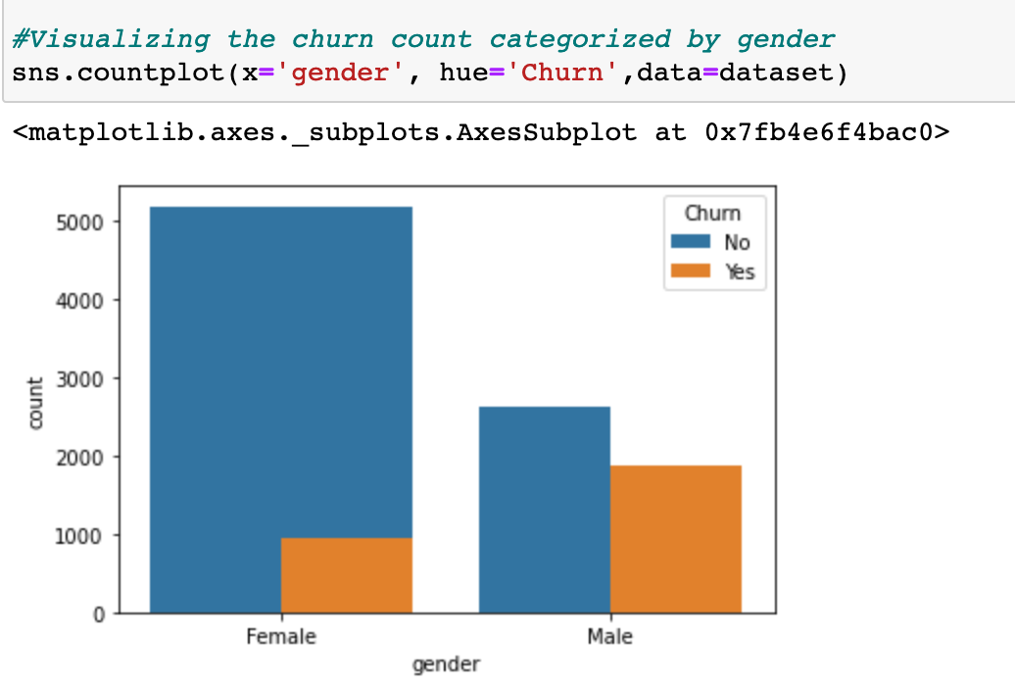
RELATIONSHIP BETWEEN CUSTOMER GENDER AND CUSTOMER CHURN
In order to check whether gender has a role in customer churn, we visualised the relationship using matplotlib

Slide 15
RELATIONSHIP BETWEEN CUSTOMER GENDER AND CUSTOMER CHURN
INSIGHTS DERIVED
By visualizing the churn count categorised by gender, it was found that the churn rate is high in case of men with a churn rate of approx 40% .
Females are more likely to stick to the company with a churn rate of 20% (approx)
SUGGESTION: Focus on strengthening customer experience and marketing strategies catering to needs of the male audience

Slide 16
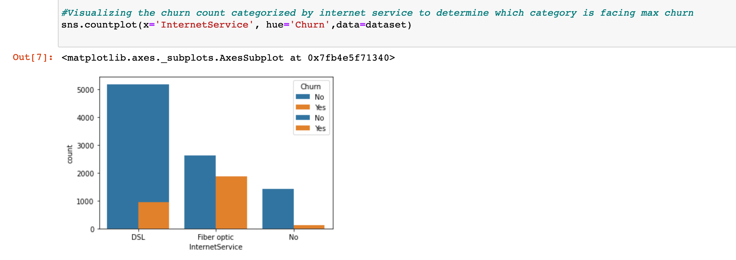
RELATIONSHIP BETWEEN INTERNET SERVICE CATEGORY AND CUSTOMER CHURN
In order to check which categories are facing maximum customer churn, we visualised the relationship using matplotlib

Slide 17
RELATIONSHIP BETWEEN INTERNET SERVICE CATEGORY AND CUSTOMER CHURN
INSIGHTS DERIVED
The chart above is interesting, because it helps us to discriminate retained and churned customers, it shows that most customers that churned had the Fiber optic internet service, and the most customers that were retained had DSL internet service.
Suggestion: Maybe the company should only provide DSL as the internet service or stop providing Fiber optics for it’s internet service.

Slide 18
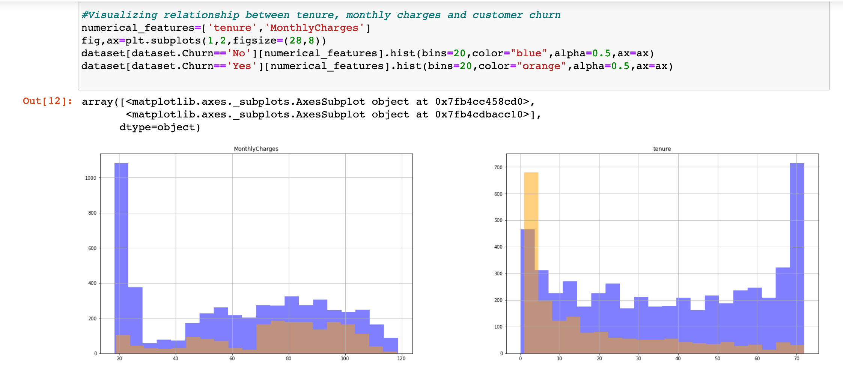
RELATIONSHIP BETWEEN MONTHLY CHARGES, TENURE AND CUSTOMER CHURN
In order to check how monthly charges and tenure affect customer churn, we visualised the relationship using matplotlib

Slide 19
RELATIONSHIP BETWEEN MONTHLY CHARGES, TENURE AND CUSTOMER CHURN
INSIGHTS DERIVED
From the previous two charts, we can clearly see that there is some discrimination in the data.
The monthly charges chart (on the left) shows that most of the loyal customers that stayed with the company had a monthly charge between $20 and $30. Most of the customers that churned had a monthly charge of $70 to $100.
Suggestion : Maybe the company should lower the monthly charges to retain customers.
Tenure chart : Shows some discrimination as well. From the chart, we can see that most of the customers that churned had between 1 and 9 months with the company, while most of the retained customers had a tenure between 24 and 72 months which is 2 to 6 years.
Suggestion: It may be in the company's best interest to try everything they can to keep their customers for at least 2 years.

Slide 20
DATA PROCESSING AND CLEANING

Slide 21
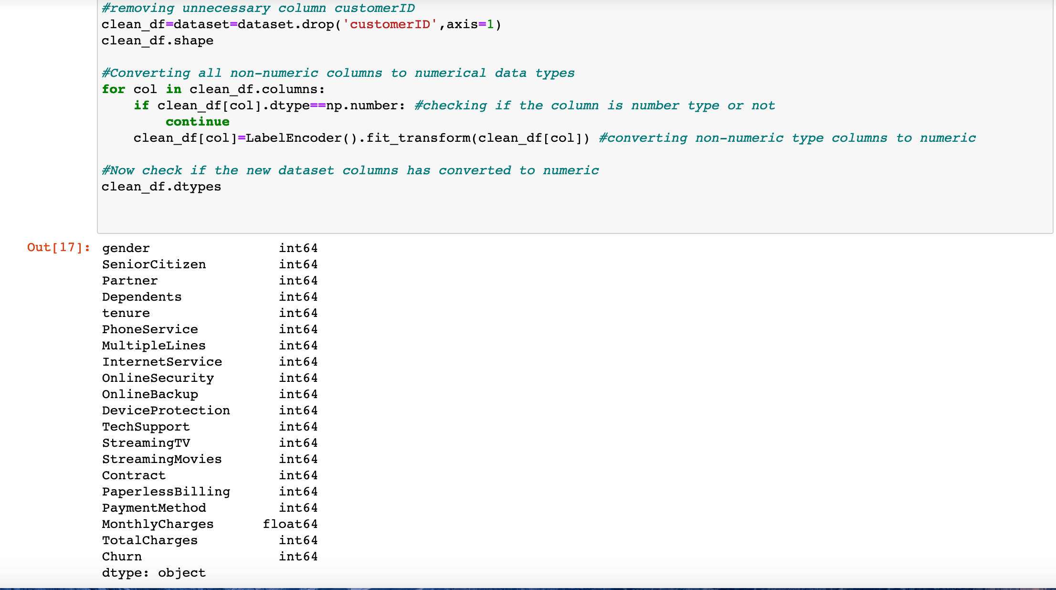
Removing unnecessary columns i.e customerID and prepare a cleaned dataset ‘clean_df’
Also, checking for non-numeric columns, then converting all non-numeric columns to numeric data types using LabelEncoder()

Slide 22
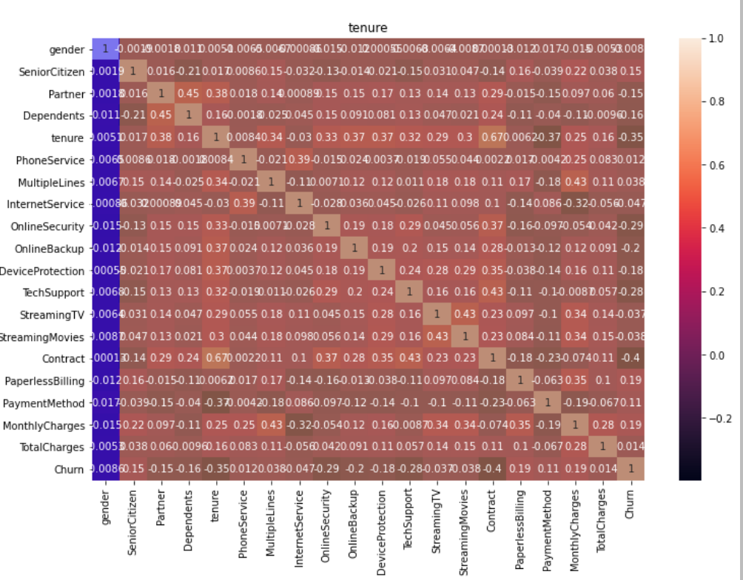
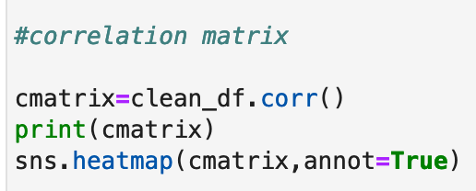
Correlation Matrix for cleaned dataset
By plotting the correlation matrix for clean_df using corr() from Pandas, we can observe that
There is low relationship between tenure and monthly charges, senior citizen and monthly charges and Senior Citizen and tenure

Slide 23
REASONS FOR CHOOSING THE LOGISTIC REGRESSION
Logistic Regression will allow for us to predict whether a customer is at risk to churn from Telco’s platform.
This model is good for binary classification. It will help us to classify our observations as the customer “will churn” or “won’t churn” from the platform.
A logistic regression model will try to guess the probability of belonging to one group or another by predicting outcome values between [0, 1].
We used the ‘Scikit Learn’ package in Python.

Slide 24
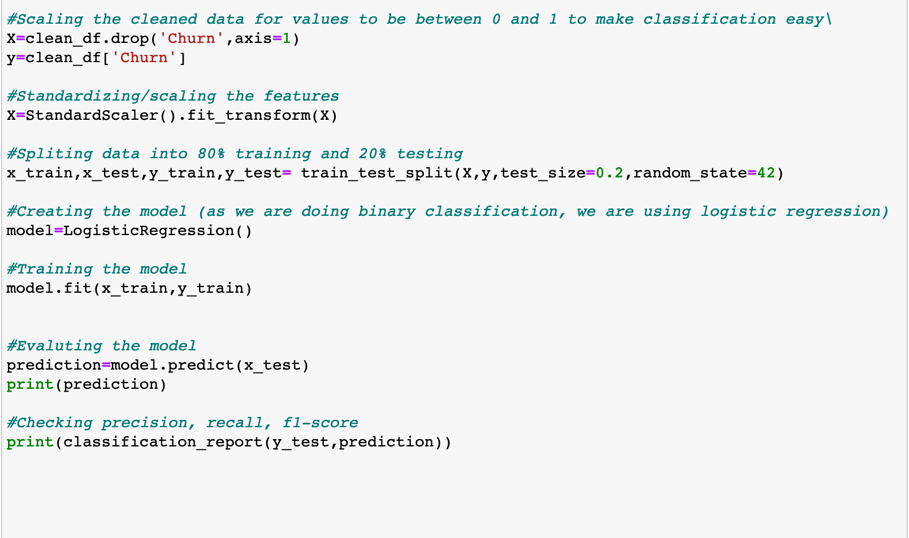
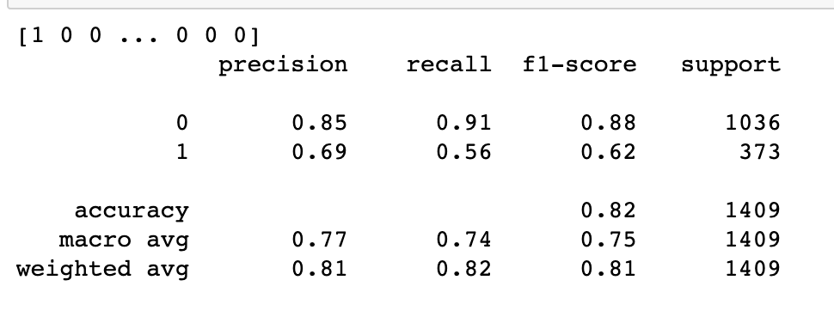
Preparing Logistic Data model for predicting customer churn by splitting the data for training (80%) and testing data (20%) using train_test_split() and creating the model using Logistic Regression.
Training the model using fit() and the evaluating the model’s accuracy,F1 Score, precision and recall

Slide 25
CONCLUSION
Recall of the model is about 91%
The model correctly identified about 91% of the customers that were retained and missed about 9%.
Precision of the model was about 85% and the f1-score was about 88%.
Accuracy of the model was about 82% which is better than the 73.46% that we could’ve done just by guessing a customer would always stay with the company.
OUR SUGGESTION : Company may want to lower it’s monthly charges at least for new customers for the first 2 years and stop providing fiber optics internet service, this may be a good strategy to help retain their customers and reduce customer Churn.

Slide 26
FUTURE SCOPE
Another branch of CU dataset can be explored. Further research is needed to handle datetime data type variables. The four machine learning techniques were used in this project on the CU dataset. Further other techniques can be explored as well.
Different machine learning algorithms can be explored, and data can be analysed. Further research can be done to build the time-series model to predict customer churn timeline.
Also, there is a scope of using clustering unsupervised machine learning technique to examine the data. The similarities in data or some patterns can be determined using this technique.
More customised strategies can be built to prevent customer churn depending on unique user profiles.
More factors and their relationship with customer churn can be considered to improve effectiveness of the model

Slide 27
THANK YOU !

